Slide 1
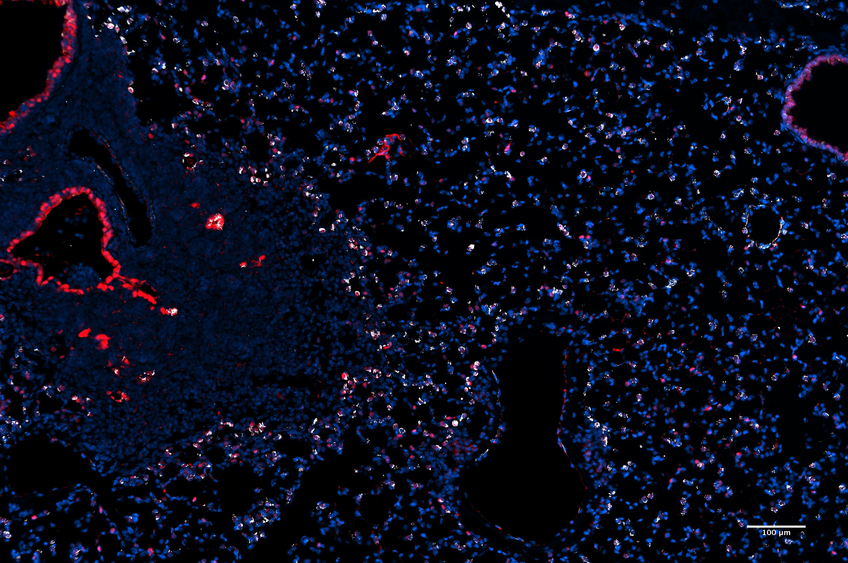
Expressed in AT2s around areas of injury
Sftpc
Klf5
DAPI
Tissue from Will Zacharius
Notes:
Talk about potential experimental design for adult flu and for alveologenesis, jeff whitset paper here and maybe some from that review
Klf5 definitely enriched in the epithelium in the adult, also expressed in secretory cells in the airways RNA scope?

Slide 2
Expressed in AT2s around areas of injury
Sftpc
Klf5
DAPI
Tissue from Will Zacharius
Notes:
Talk about potential experimental design for adult flu and for alveologenesis, jeff whitset paper here and maybe some from that review
Klf5 definitely enriched in the epithelium in the adult, also expressed in secretory cells in the airways RNA scope?

Slide 3
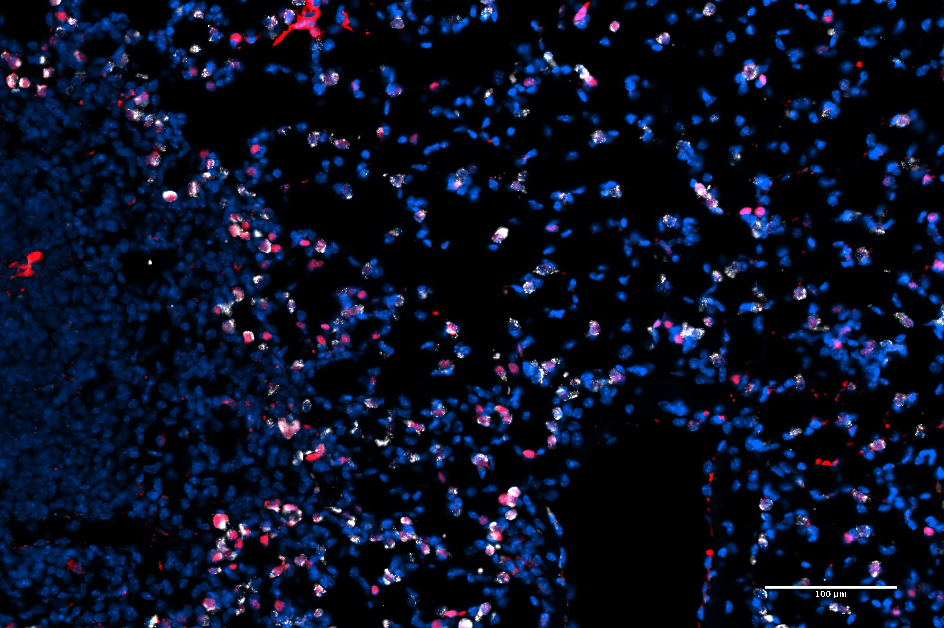
Expressed in AT2s around areas of injury
Sftpc
Klf5
DAPI
Tissue from Will Zacharius
Notes:
Expressed in AT2s, particularly around area of injury. May be upregulated in those areas. Yellow cells it is either not expressed, or more likely lowly expressed and would should up more clearly on confocal. But what is it doing?

